Slide 1
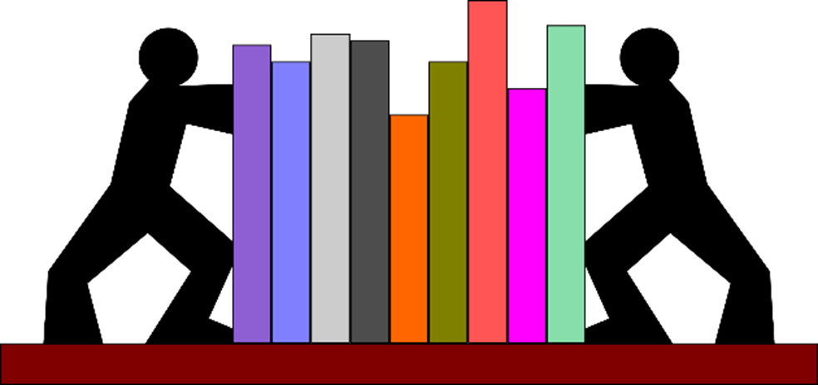
Designing an effective lesson with active strategies
Lorae Roukema, Ed.D
School of Education & Human Sciences

Slide 2
Ticket in the door
What do you know about how people learn?
If you are watching this virtually, please post your thoughts in the Chat Box.

Slide 3
Draw a picture of learning

Slide 4
What is learning?
Smilkstein, R. (2011). We’re born to learn (2ndEd). Corwin

Slide 5
Notes:
The more a path is used, the more defined and easier to travel it becomes.
Habits or patterns of thinking make pathways between interconnects shorter and shorter with use
Strengthening Neural Pathways is what the point of our classes should be.

Slide 6
Dendrites, synapses and neural networks……
Think-Pair-Share or In the Chat Box
What are the implications of each of these statements?
1. Grow only from what is already there
2. Grow from what is actively, personally, and specifically experienced
3. Grow from stimulating experiences
____________________________________
4. Use it or lose it (pruning)
Notes:
Discuss the implications of each of these statements.

Slide 7
The Learning Pyramid
Notes:
Whoever is doing the doing is working the hardest, and whoever is working the hardest is doing the learning.
What activities do you know or already do that involve this sort of knowledge construction?

Slide 8
What is ACTIVE learning?

Slide 9
Engaging students mentally, emotionally, or physically in the construction of knowledge
Notes:
Why is active learning important?

Slide 10
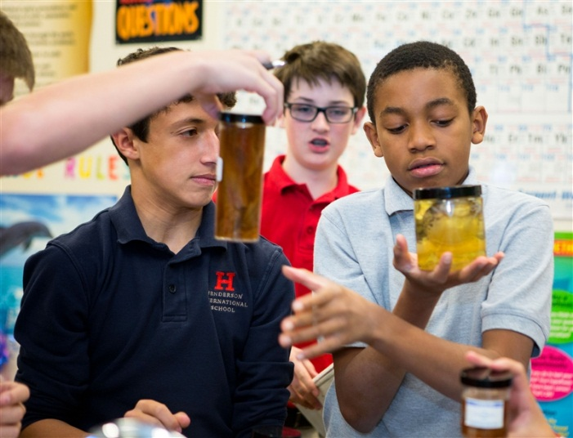
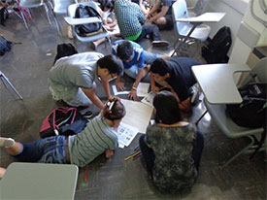
Three Dimensions of Active Learning
Intellectually Active Learning
Physically Active Learning
Socially Active Learning
(Edwards, 2015)
Notes:
As we go through these 3 dimensions, think about the strategies you found and be prepared to discuss.

Slide 11
Intellectually Active Learning
Intellectually Active Learning
Physically Active Learning
Socially Active Learning
Passive Learning
Active Learning
Students passively receive information from their teacher.
Emphasis is on factual learning.
Teacher is the source of knowledge of the content.
Students are viewed as empty vessels and a transmission approach is used to deliver and recall knowledge.
Students are actively engaged in constructing their learning.
Emphasis is on problem-solving, application, and critical thinking
Teacher is a source of discipline expertise but also a facilitator of learning.
Students are empowered to seek out new knowledge and apply that knowledge in new contexts.
Notes:
Multiple perspectives
Concept Maps & Organizers
Big Ideas

Slide 12
Socially Active Learning
Intellectually Active Learning
Physically Active Learning
Socially Active Learning
Importance of social construction of knowledge (Vygotsky)
Collaboration & Cooperation as skills
Notes:
6-3-1: Write down 6 most important ideas. In groups of 3, narrow your 3 lists to the 3 most important concepts; Share 1 idea with the class.
Numbered Heads Together: Each person on the team gets a number. Question is asked and group answers it collaboratively. Teacher calls out a number and that person answered in behalf of the group

Slide 13
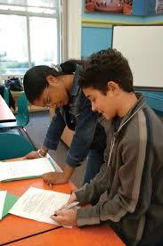
Physically Active Learning
Intellectually Active Learning
Physically Active Learning
Socially Active Learning
Attention span is generally 7-10 minutes
Physical activity increases blood flow, and therefore, oxygen to the brain
Notes:
Endocrine system is still in development
Adrenaline surges cause an urge to move
Metabolic system is still in development
Periods of extreme restlessness to periods of extreme fatigue
During puberty the last 3 vertebrae fuse to form the tailbone

Slide 14
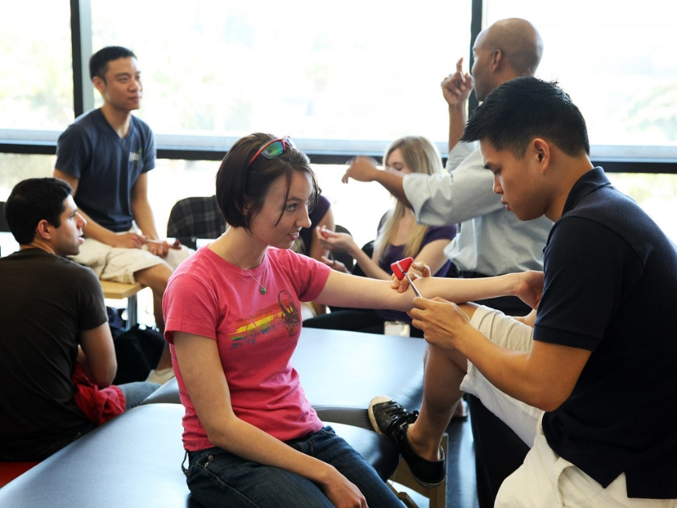
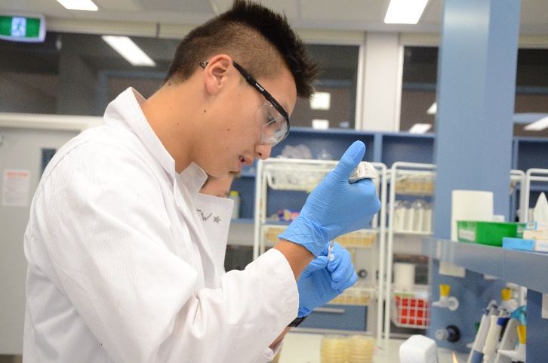
Goes without Saying…
All of this must be purposeful.
Our goal isn’t fun…although fun is okay
Our goal isn’t movement for movement’s sake
Our goal isn’t just getting people to talk
Our goal is active, purposeful learning.

Slide 15
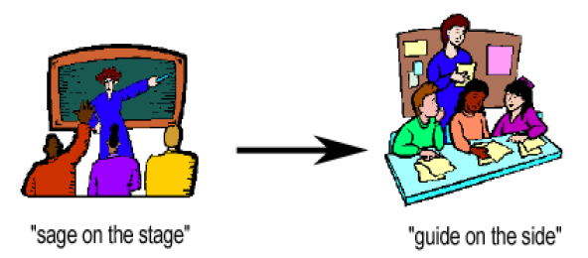
Sage on the Stage versus Guide on the Side
PUSH versus PULL

Slide 16
What are obstacles to active learning?

Slide 17
What are obstacles to active learning?
Lectures alone are too often a useless expenditure of force. The lecturer pumps laboriously into sieves. The water may be wholesome; but it runs through. A mind must work to grow.
(Eliot, 1869).
Notes:
President of Harvard University; noted that university’s needed educational reform

Slide 18
What makes a lesson effective?

Slide 19
Chunking
Notes:
Activities

Slide 20
Interactive Strategies
Look through the provided handout and mark any activities that you might integrate.
Don’t be afraid to TWEAK.
Notes:
Pass out handout
Discuss

Slide 21
Infusing active strategies for more effective lessons
Think about a class you have coming up in the next week or so.
What is your Focus or Review activity?
What activities will engage students to THINK throughout your lesson? How are these chunked?
What will you have the students do for closure?
Notes:
Use the handouts and ideas of today to work on a class.
Think. Discuss.

Slide 22
GOTS
WANTS
Closure
If you are virtual, please use the chat box to record your thoughts
Notes:
What is something interesting or valuable you learned today? What would you still like to know?

